Slide 1
Object Oriented Data Base: Basic Concepts
Prof.Dr. Ahmed Abou elfetouh

Slide 2
Background
Relational DBMSs support a small, fixed collection of data types (e.g. integer, dates, string, etc.) which has proven adequate for traditional application domains such as administrative and business data processing. RDBMSs support very high-level queries, query optimization, transactions, backup and crash recovery, etc.

Slide 3
Background
However, many other application domains need complex kinds of data such as CAD/CAM, multimedia repositories, and document management. To support such applications, DBMSs must support complex data types.
Object-oriented strongly influenced efforts to enhance database support for complex data and led to the development of object-database systems.

Slide 4
Object-database systems have developed along two distinct paths:
(1) Object-Oriented Database Systems. The approach is heavily influenced by OO programming languages and can be understood as an attempt to add DBMS functionality to a programming language environment.
- The Object Database Management Group (ODMG) has developed a standard Object Data Model (ODM) and Object Query Language (OQL), which are the equivalent of the SQL standard for relational database systems.

Slide 5
Object-database systems have developed along two distinct paths: (Cont..)
(2) Object-Relational Database Systems. ORDB systems can be thought of as an attempt to extend relational database systems with the functionality necessary to support a broader class of application domains, provide a bridge between the relational and object-oriented paradigms.
This approach attempts to get the best of both - The Object Database Management Group (ODMG) has developed a standard Object Data Model (ODM) and Object Query Language (OQL), which are the equivalent of the SQL standard for relational database systems.

Slide 6
What is Object Oriented (OO) Data Base
Object Oriented Data Base (OODB) is all facilities associated with object oriented paradiam .
It enabled thus creats Classes , Objects, Structure, Inheeritance hierarchy and all methods other classes .

Slide 7
What is Object Oriented (OO) Data Base(Cont..)
Beside these it also provide facilities with standard data base systems.
However, OODB have not yet replace RDBMS in commercial business applications .

Slide 8
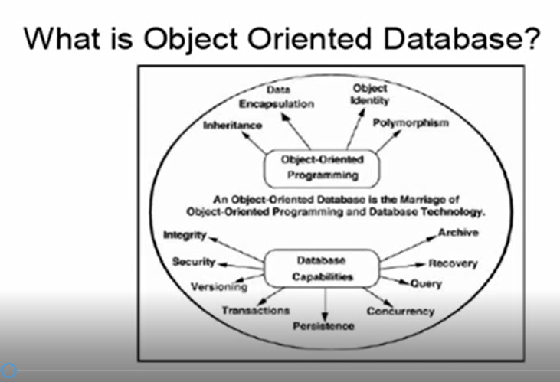
OODBS

Slide 9
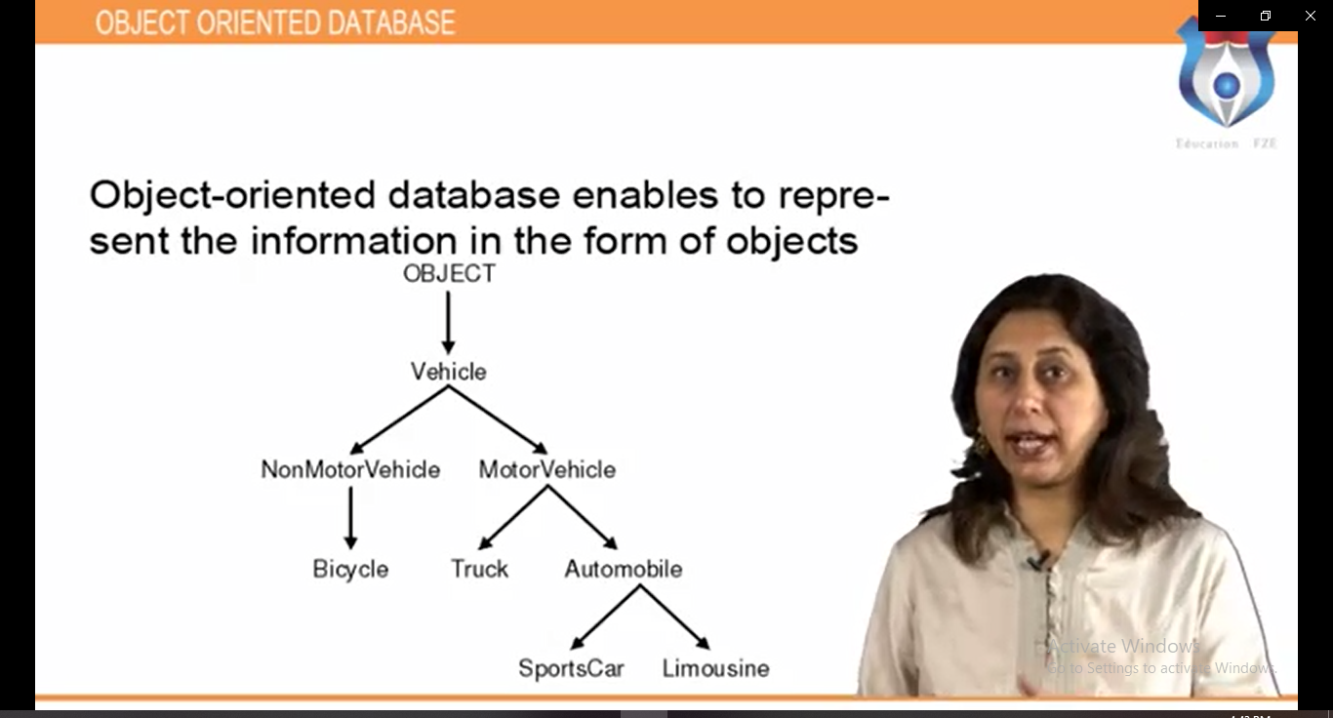
Object oriented databse enables to represent information in the form of objects .

Slide 10
What is Object Oriented (OO) Data Base(Cont..)
Object oriented data base present data modeling and programming in an object oriented environment.

Slide 11
What is Object Oriented (OO) Data Base(Cont..)
Object oriented data base present data modeling and programming in an object oriented environment.

Slide 12
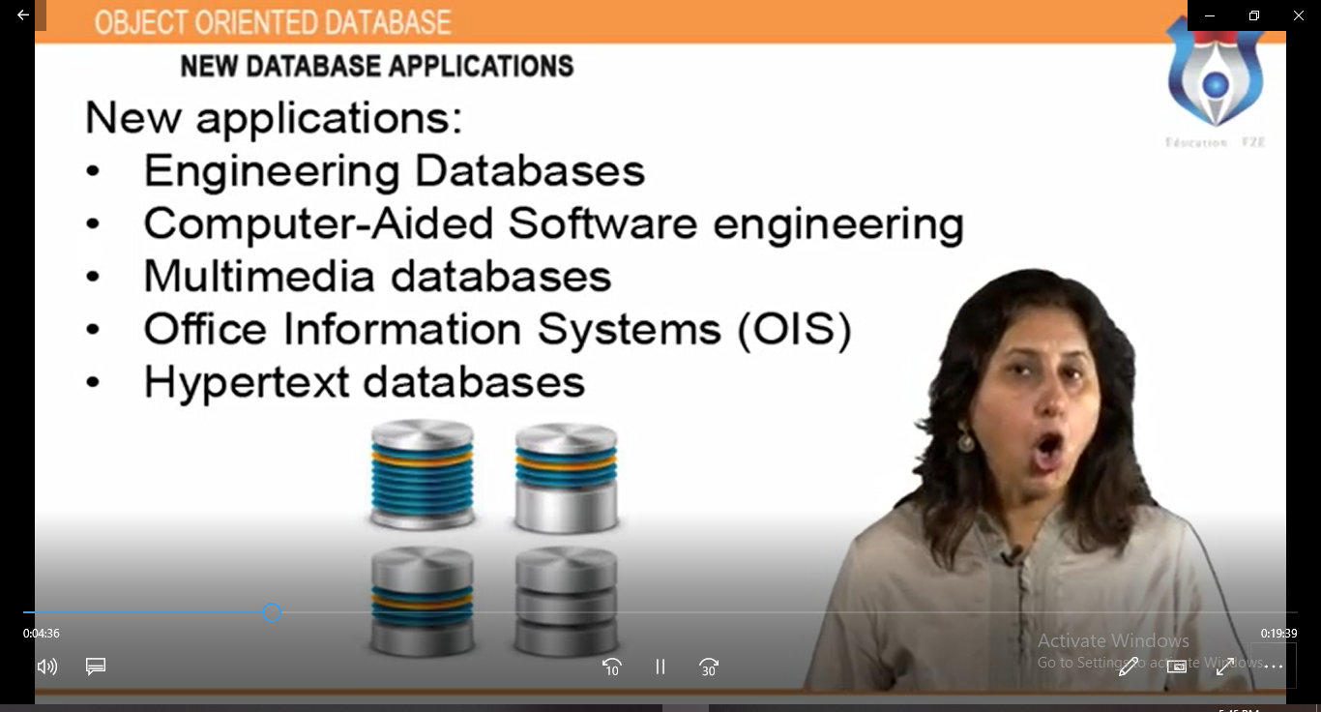
New Database Applications

